Slide 1
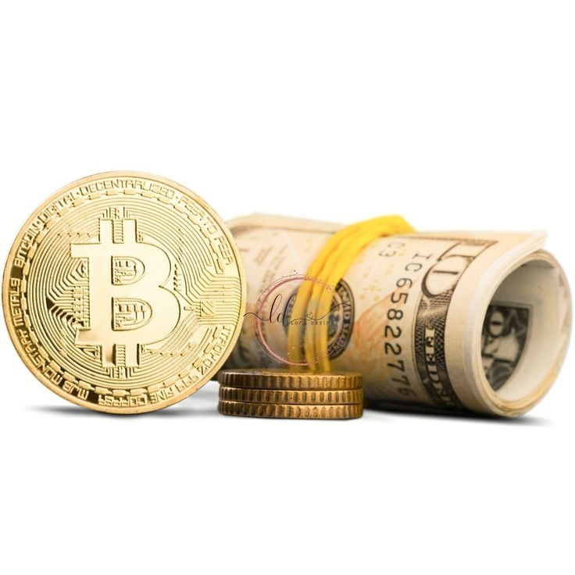
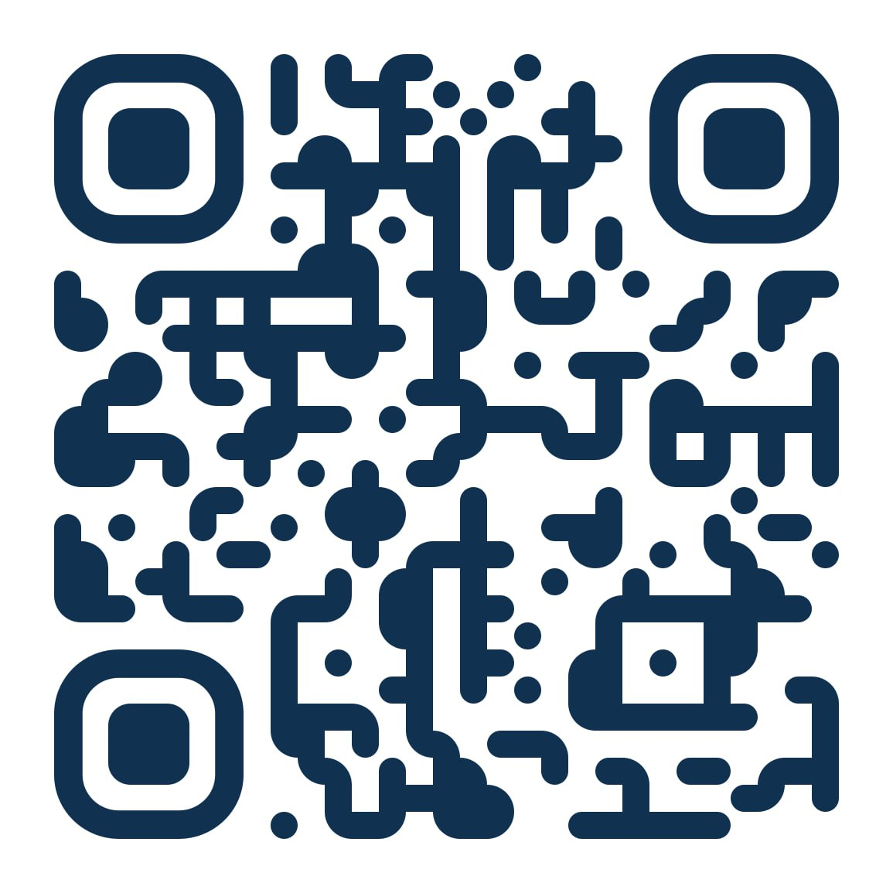
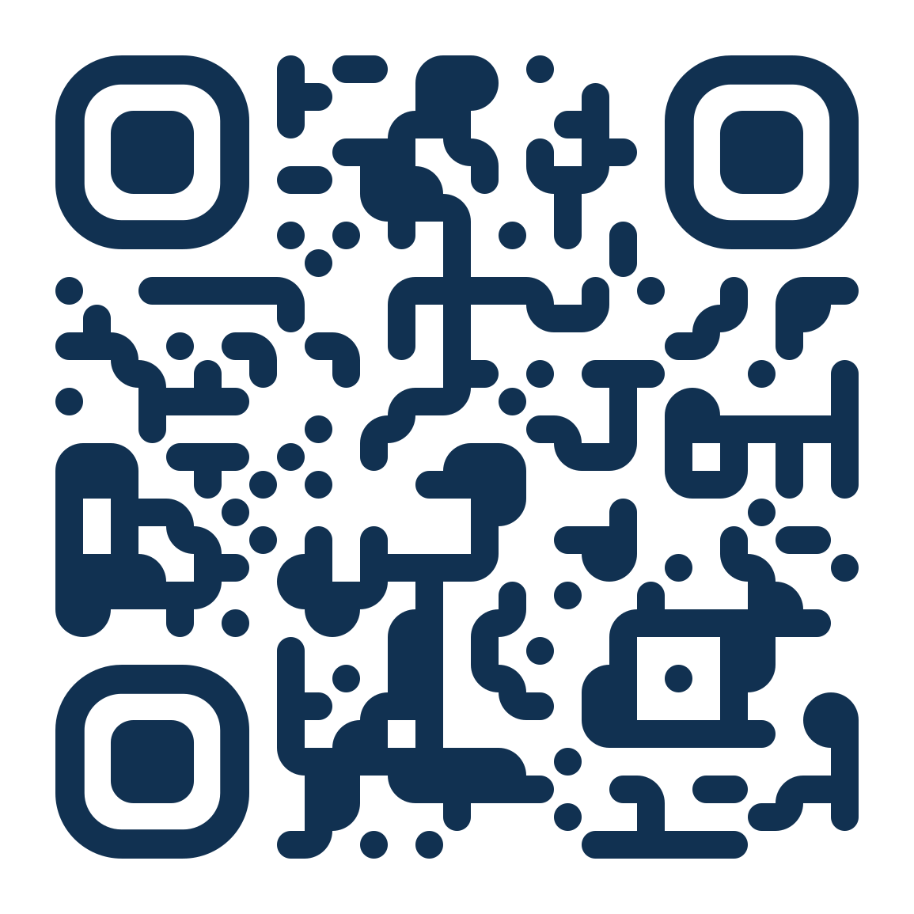
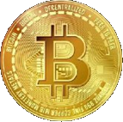
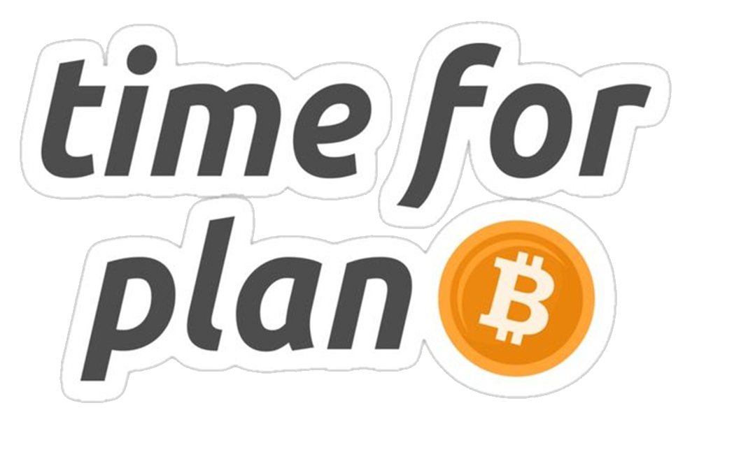
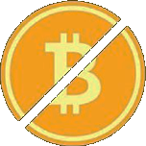
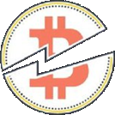

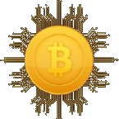
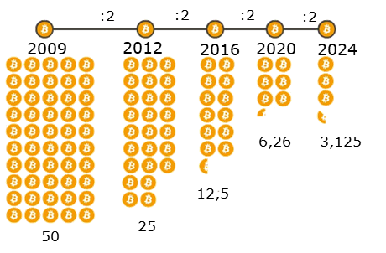
Join the
Kalmar Bitcoin Community !
WHAT IS "BITCOIN HALVING"??
Bitcoin halving is a preprogrammed event that reduces the rate at which new Bitcoins are created, happening approximately every four years.
HOW DOES IT WORK?
Every 210,000 blocks mined, the reward miners receive for validating transactions is cut in half.
join online
pdf download
WHY DOES IT MATTER?
Scarcity: Halving reduces the rate at which new Bitcoins enter circulation, increasing scarcity and potentially driving up value.
HISTORICAL IMPACT
Previous halvings have historically been followed by signification price increases, attracting attention from investors and traders.
BITCOIN IS BETTER THAN YOU THINK!
LONG-TERM IMPLICATIONS
The final Bitcoin will be mined around 2140 when the reward becomes minuscule, making it extremely scarce.
© Kalmar Bitcoin Community - concept . design by Ramona Heller

Slide 2

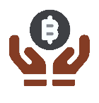



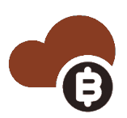
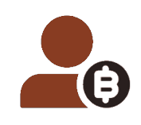






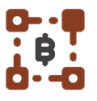
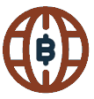
Bitcoin makes it possible to really own your money!
Inflation is worse than you think!
6 REASONS WHY
BITCOIN HAS VALUE
In the past, our money was backed by gold reserves so that it was limited and retained its value. This has no longer been the case since 1971.
Prices are rising wherever you look, goods and services become more expensive, but your wages can't keep up...But why is that?
SCARCE
There will be only < 21 million Bitcoin to ever exist
TRANSPARENT
You can verify where your Bitcoin came from and where it goes
Nowadays, banks simply create new money out of nothing. This is not possible with Bitcoin.
If the money supply is increased (through "rescue packages", government debt, etc.), the money saved loses purchasing power.
Bitcoin is the only digital asset that is really scarce.
Creating new monetary units does not create wealth.
DECENTRALIZED
Its core code and info are stored on multiple servers in the world
FREEDOM
BTC can´t be controlled by any government,
bank or company
Bitcoin is the largest and most secure computer network in the world and it requires energy to secure and protect it from manipulation.
Money that can be created without effort is not scarce and is called "soft money".
The more people use Bitcoin, the greater the value per unit becomes, while the price fluctuates less and less.
Due to the Cantillon effect, printing new "soft money" widens the gap between rich and poor.
FUNGIBLE
Bitcoin is perfectly
interchangeable
BORDERLESS
Bitcoin can be sent worldwide in no time

